Slide 1
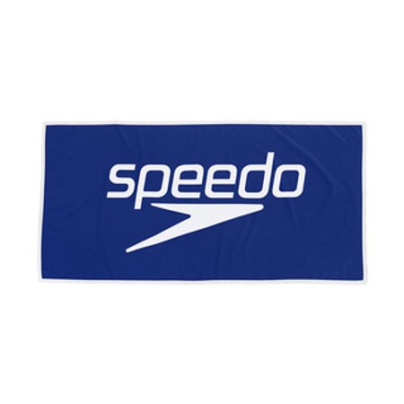
Breaker 2021 Suits
Speedo Hydro Amp
Flyback $62.00

Slide 2
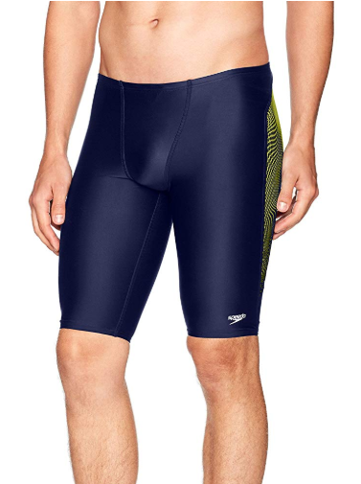
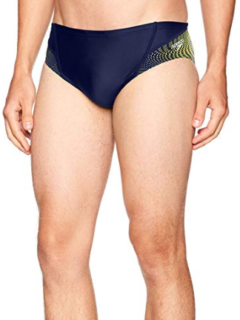
Jammer $42.00
Brief $36.00

Slide 3
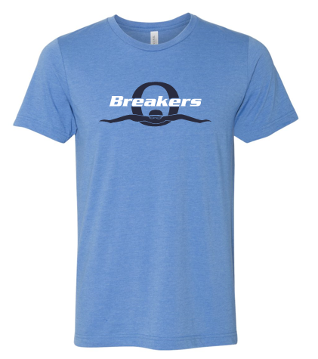
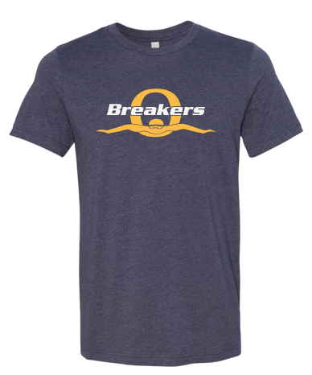
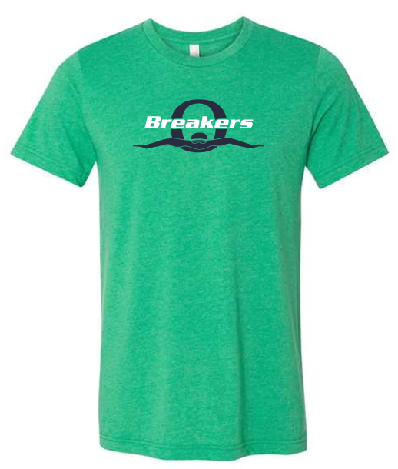
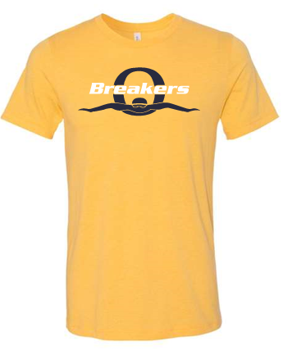
Item #2
Item #3
Item #1
Canvas® Soft Jersey Tee
$12.00
4.2 oz, 52/48 Airlume combed and ringspun cotton/polyester
32 singles (fine yarn giving the shirt it’s soft hand)
Retail fit
Pricing quoted for S-XL (upcharges apply for larger sizes)
Item #4

Slide 4
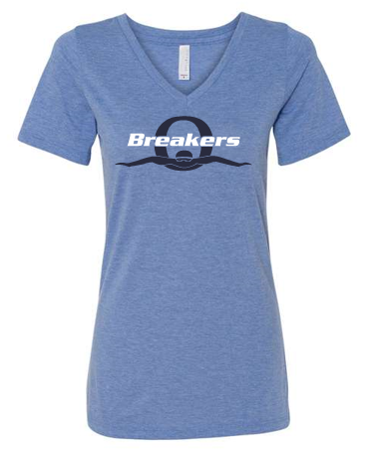
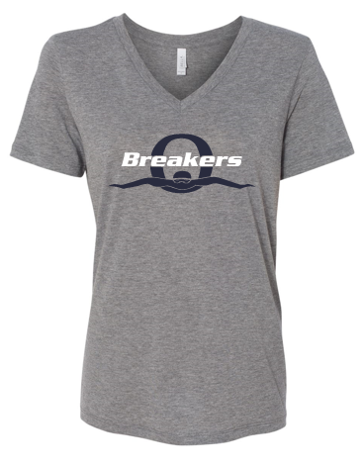
Item #5
Item #6
Canvas® Ladies V Neck TriBlend
$12.00
Triblends are super soft. 3.8 oz., 50/25/25 polyester/airlume combed and ringspun cotton/rayon, 40 singles; Relaxed fit
Pricing quoted for S-XL (upcharges apply for larger sizes)

Slide 5
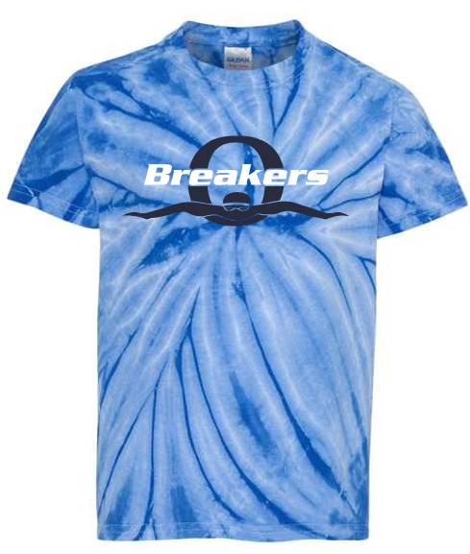
Tie Dye Tee
$15.00
5.3 oz., 100% pre-shrunk cotton
Double-needle stitched neckline and sleeves
Pricing quoted for S-XL (upcharges apply for larger sizes)
Item #7

Slide 6
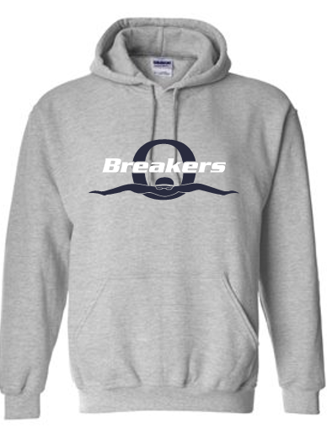
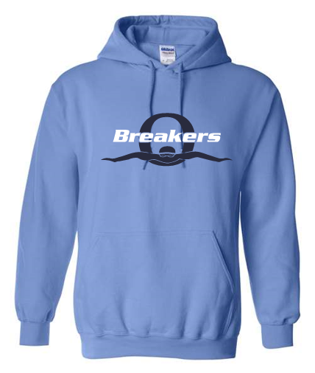
Gildan HeavyBlend® Hoodies
$20.00 S-XL
Upcharges apply for larger sizes
Item #8
Item #9

Slide 7
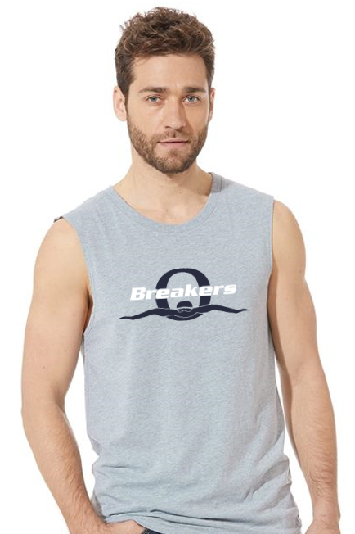
Next Level® Unisex Muscle Shirt (unisex adult)
$12.00
4.0 oz., 60/40 combed ring-spun cotton/polyester
30 singles; Set-in 1x1 baby rib collar
Hemmed armholes
Pricing quoted for S-XL (upcharges apply for larger sizes)
Item #10

Slide 8
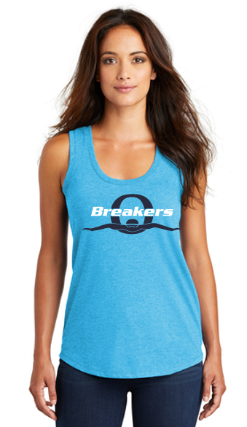
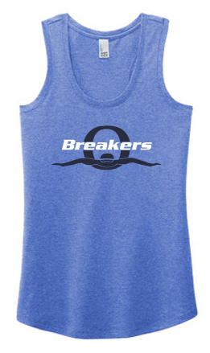
District® Womens Perfect TriBlend Racerback Tank
$12.00
The perfect mixture of softness, comfort and easy wear.
4.5-ounce, 50/25/25 poly/combed ring spun cotton/rayon
32 singles; 1x1 rib knit neck and arm holes Curved hem
Pricing quoted for S-XL (upcharges apply for larger sizes)
Item #12
Item #11

Slide 9
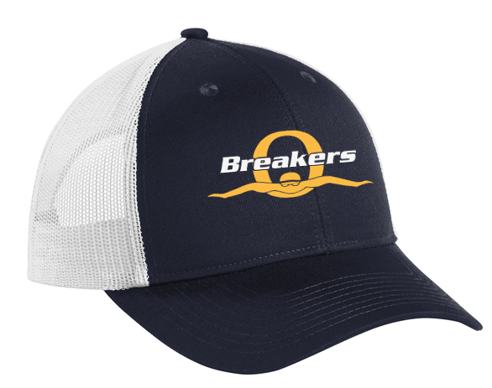
Mesh Back Cap
$10.00
Fabric: 100% cotton twill front panels and bill
100% polyester mesh mid and back panels Structured; Medium Profile
7-position adjustable snapback
Navy/White with embroidered logo
Item #13

Slide 10
$25.00 For Purchase Today
Item 18
30 x 60 Beach Towel

